Slide 1
Chapter 3
Manipulating Strings
PHP Programming with MySQL
2nd Edition

Slide 2
Objectives
In this chapter, you will:
Construct text strings
Work with single strings
Work with multiple strings and parse strings
Compare strings
Use regular expressions
PHP Programming with MySQL, 2nd Edition

Slide 3
Constructing Text Strings
A text string contains zero or more characters surrounded by double or single quotation marks
Text strings can be used as literal values or assigned to a variable
  echo "<PHP literal text string</p>";
  $StringVariable = "<p>PHP literal text string</p>";
  echo $StringVariable;
A string must begin and end with a matching quotation mark (single or double)
PHP Programming with MySQL, 2nd Edition

Slide 4
Constructing Text Strings (continued)
To include a quoted string within a literal string surrounded by double quotation marks, you surround the quoted string with single quotation marks
To include a quoted string within a literal string surrounded by single quotation marks, you surround the quoted string with double quotation marks
PHP Programming with MySQL, 2nd Edition

Slide 5
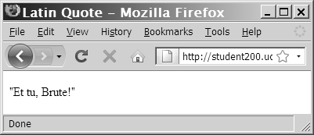
Constructing Text Strings (continued)
$LatinQuote = '<p>"Et tu, Brute!"</p>';
echo $LatinQuote;
Figure 3-2 Output of a text string containing double quotation marks
PHP Programming with MySQL, 2nd Edition

Slide 6
Working with String Operators
In PHP, you use two operators to combine strings:
Concatenation operator (.) combines two strings and assigns the new value to a variable
  $City = "Paris";
  $Country = "France";
  $Destination = <p>“ . $City . " is in "
  . $Country . ".</p>";
  echo $Destination;
PHP Programming with MySQL, 2nd Edition

Slide 7
Working with String Operators (continued)
You can also combine strings using the concatenation assignment operator (.=)
  $Destination = "<p>Paris";
  $Destination .= "is in France.</p>";
  echo $Destination;
PHP Programming with MySQL, 2nd Edition

Slide 8
Adding Escape Characters and Sequences
An escape character tells the compiler or interpreter that the character that follows it has a special purpose
In PHP, the escape character is the backslash (\)
echo '<p>This code\'s going to work</p>';
Do not add a backslash before an apostrophe
if you surround the text string with double
quotation marks
echo "<p>This code's going to work.</p>";
PHP Programming with MySQL, 2nd Edition

Slide 9
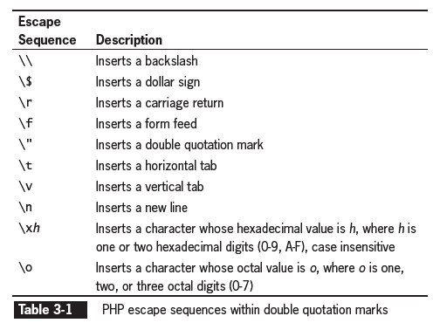
Adding Escape Characters and Sequences (continued)
The escape character combined with one or more other characters is an escape sequence
PHP Programming with MySQL, 2nd Edition

Slide 10
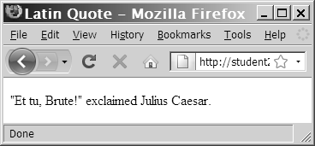
Adding Escape Characters and Sequences (continued)
$Speaker = "Julius Caesar";
echo "<p>\"Et tu, Brute!\" exclaimed $Speaker.</p>";
Figure 3-4 Output of literal text containing double quotation escape sequences
PHP Programming with MySQL, 2nd Edition

Slide 11
Simple and Complex String Syntax
Simple string syntax uses the value of a variable within a string by including the variable name inside a text string with double quotation marks
  $Vegetable = "broccoli";
  echo "<p>Do you have any $Vegetable?</p>";
When variables are placed within curly braces inside of a string, it is called complex string syntax
  $Vegetable = "carrot";
  echo "<p>Do you have any {$Vegetable}s?</p>";
PHP Programming with MySQL, 2nd Edition

Slide 12
Working with a Single String
PHP provides a number of functions for analyzing, altering, and parsing text strings including:
  Counting characters and words
  Transposing, converting, and changing the case of text within a string
PHP Programming with MySQL, 2nd Edition

Slide 13
Counting Characters and Words in a String
The most commonly used string counting function is the strlen() function, which returns the total number of characters in a string
Escape sequences, such as \n, are counted as one character
  $BookTitle = "The Cask of Amontillado";
  echo "<p>The book title contains " .
  strlen($BookTitle) . " characters.</p>";
PHP Programming with MySQL, 2nd Edition

Slide 14
Counting Characters and Words in a String (continued)
The str_word_count() function returns the number of words in a string
Pass the str_word_count() function a literal string or the name of a string variable whose words you want to count
$BookTitle = "The Cask of Amontillado";
echo "<p>The book title contains " .
str_word_count($BookTitle). " words.</p>";
PHP Programming with MySQL, 2nd Edition

Slide 15
Modifying the Case of a String
PHP provides several functions to manipulate the case of a string
  The strtoupper()function converts all letters in a string to uppercase
  The strtolower()function converts all letters in a string to lowercase
  The ucfirst()function ensures that the first character of a word is uppercase
  The lcfirst()function ensures that the first character of a word is lowercase
PHP Programming with MySQL, 2nd Edition

Slide 16
Modifying the Case of a String
(continued)
Functions to manipulate the case of a string:
  The ucwords()function changes the first character of each word
    Use the strtolower()function on a string before using the ucfirst()and ucwords() to ensure that the remaining characters in a string are in lowercase
    Use the strtoupper()function on a string before using the ucfirst() and ucwords() to ensure that the remaining characters in a string are in uppercase
PHP Programming with MySQL, 2nd Edition

Slide 17
Encoding and Decoding a String
PHP has several built-in functions to use with Web pages:
Some characters in XHTML have a special meaning and must be encoded using HTML entities in order to preserve that meaning
  The htmlspecialchars()function converts special characters to HTML entities
  The html_specialcharacters_decode() function converts HTML character entities into their equivalent characters
PHP Programming with MySQL, 2nd Edition

Slide 18
Encoding and Decoding a String
(continued)
The characters that are converted with the htmlspecialchars()function are:
  '&' (ampersand) becomes '&amp;'
  '"' (double quote) becomes '&quot;' when ENT_NOQUOTES is disabled.
  ''' (single quote) becomes '&#039;' only when ENT_QUOTES is enabled.
  '<' (less than) becomes '&lt;'
  '>' (greater than) becomes '&gt;'
PHP Programming with MySQL, 2nd Edition

Slide 19
Encoding and Decoding a String
(continued)
If ENT_QUOTES is enabled in the PHP configuration, both single and double quotes are converted
If ENT_QUOTES is disabled in the PHP configuration, neither single nor double quotes are converted
PHP Programming with MySQL, 2nd Edition

Slide 20
Encoding and Decoding a String
(continued)
The md5()function uses a strong encryption algorithm (called the Message-Digest Algorithm) to create a one-way hash
  A one-way hash is a fixed-length string based on the entered text, from which it is nearly impossible to determine the original text
  The md5() function does not have an equivalent decode function, which makes it a useful function for storing passwords in a database
PHP Programming with MySQL, 2nd Edition

Slide 21
Other Ways to Manipulate a String
PHP provides three functions that remove leading or trailing spaces in a string
  The trim()function will strip (remove) leading or trailing spaces in a string
  The ltrim() function removes only the leading spaces
  The rtrim() function removes only the trailing spaces
PHP Programming with MySQL, 2nd Edition

Slide 22
Other Ways to Manipulate a String (continued)
The substr()function returns part of a string based on the values of the start and length parameters
The syntax for the substr() function is:
substr(string, start, optional length);
A positive number in the start parameter indicates how many character to skip at the beginning of the string
A negative number in the start parameter indicates how many characters to count in from the end of the string
PHP Programming with MySQL, 2nd Edition

Slide 23
Other Ways to Manipulate a String
(continued)
A positive value in the in the length parameter determines how many characters to return
A negative value in the length parameter skip that many characters at the end of the string and returns the middle portion
If the length is omitted or is greater than the remaining length of the string, the entire remainder of the string is returned
PHP Programming with MySQL, 2nd Edition

Slide 24
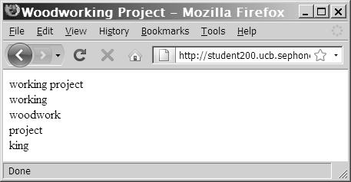
Other Ways to Manipulate a String
(continued)
$ExampleString = "woodworking project";
echo substr($ExampleString,4) . "<br />\n";
echo substr($ExampleString,4,7) . "<br />\n";
echo substr($ExampleString,0,8) . "<br />\n";
echo substr($ExampleString,-7) . "<br />\n";
echo substr($ExampleString,-12,4) . "<br />\n";
Figure 3-10 Some examples using the substr() function
PHP Programming with MySQL, 2nd Edition

Slide 25
Working with Multiple Strings
Parsing is the act of dividing a string into logical component substrings or tokens
When programming, parsing refers to the extraction of information from string literals
and variables
PHP Programming with MySQL, 2nd Edition

Slide 26
Finding and Extracting Characters and Substrings
There are two types of string search and extraction functions:
  Functions that return a numeric position in a text string
  Functions that return a character or substring
    Both functions return a value of FALSE if the search string is not found
PHP Programming with MySQL, 2nd Edition

Slide 27
Finding and Extracting Characters and Substrings (continued)
The strpos() function performs a case-sensitive search and returns the position of the first occurrence of one string in another string
Pass two arguments to the strpos() function:
  The first argument is the string you want to search
  The second argument contains the characters for which you want to search
If the search string is not found, the strpos() function returns a Boolean value of FALSE
PHP Programming with MySQL, 2nd Edition

Slide 28
Finding and Extracting Characters and Substrings (continued)
Pass to the strchr() and the strrchr() functions the string and the character for which you want to search
Both functions return a substring from the specified characters to the end of the string
strchr() function starts searching at the beginning of a string
strrchr() function starts searching at the
end of a string
PHP Programming with MySQL, 2nd Edition

Slide 29
Replacing Characters and Substrings
The str_replace() and str_ireplace() functions both accept three arguments:
  The string you want to search for
  A replacement string
  The string in which you want to replace characters
$Email = "president@whitehouse.gov";
$NewEmail = str_replace("president", "vice.president", $Email);
echo $NewEmail; // prints 'vice.president@whitehouse.gov'
PHP Programming with MySQL, 2nd Edition

Slide 30
Dividing Strings into Smaller Pieces
Use the strtok() function to break a string into smaller strings, called tokens
The syntax for the strtok() function is:
$variable = strtok(string, separators);
The strtok() function returns the entire string if:
  An empty string is specified as the second argument of the strtok() function
  The string does not contain any of the separators specified
PHP Programming with MySQL, 2nd Edition

Slide 31
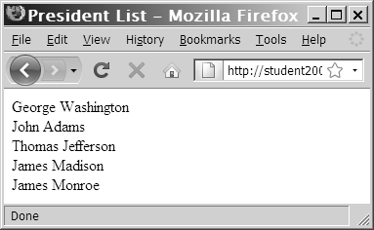
Dividing Strings into Smaller Pieces (continued)
$Presidents = " George Washington;John Thomas Jefferson;James Madison;James Monroe";
$President = strtok($Presidents, ";");
while ($President != NULL) {
echo "$President<br />";
$President = strtok(";");
}
Figure 3-15 Output of a script that uses the strtok() function
PHP Programming with MySQL, 2nd Edition

Slide 32
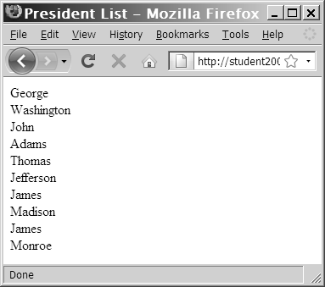
Dividing Strings into Smaller Pieces(continued)
$Presidents = " George Washington;John Adams;Thomas Jefferson;James Madison;James Monroe";
$President = strtok($Presidents, "; ");
while ($President != NULL) {
echo "$President<br />";
$President = strtok("; ");
}
Figure 3-16 Output of a script
with a strtok() function
that uses two separators
PHP Programming with MySQL, 2nd Edition

Slide 33
Converting between Strings and Arrays
The str_split() and explode() functions split a string into an indexed array
The str_split() function splits each character in a string into an array element using the syntax:
$array = str_split(string[, length]);
The length argument represents the number
of characters you want assigned to each array element
PHP Programming with MySQL, 2nd Edition

Slide 34
Converting between Strings and Arrays (continued)
The explode() function splits a string into an indexed array at a specified separator
The syntax for the explode() function is:
$array = explode(separators, string);
The order of the arguments for the explode() function is the reverse of the arguments for the strtok() function
PHP Programming with MySQL, 2nd Edition

Slide 35
Converting between Strings and Arrays (continued)
$Presidents = "George Washington;JohnAdams; Thomas Jefferson;James Madison;James Monroe";
$PresidentArray = explode(";", $Presidents);
foreach ($PresidentArray as $President) {
echo "$President<br />";
}
If the string does not contain the specified separators, the entire string is assigned to the
first element of the array
PHP Programming with MySQL, 2nd Edition

Slide 36
Converting between Strings and Arrays (continued)
The explode() function
  Does not separate a string at each character that is included in the separator argument
  Evaluates the characters in the separator argument as a substring
  If you pass to the explode()function an empty string as the separator argument, the function returns a Boolean value of FALSE
PHP Programming with MySQL, 2nd Edition

Slide 37
Converting between Strings and Arrays (continued)
The implode()function combines an array’s elements into a single string, separated by specified characters
The syntax is:
$variable = implode(separators, array);
PHP Programming with MySQL, 2nd Edition

Slide 38
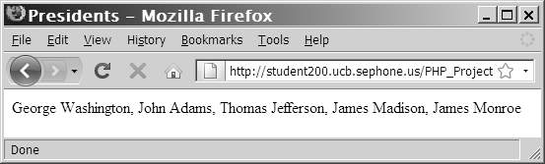
Converting between Strings and Arrays (continued)
$PresidentsArray = array("George Washington", “John Adams",
“Thomas Jefferson", “James Madison", “James Monroe");
$Presidents = implode(", ", $PresidentsArray);
echo $Presidents;
Figure 3-18 Output of a string created with the implode() function
PHP Programming with MySQL, 2nd Edition

Slide 39
Comparing Strings
Comparison operators compare individual characters by their position in the American Standard Code for Information Interchange (ASCII), which are numeric representations of English characters
$FirstLetter = "A";
$SecondLetter = "B";
if ($SecondLetter > $FirstLetter)
echo "<p>The second letter is higher in the alphabet
than the first letter.</p>";
else
echo "<p>The second letter is lower in the alphabet than
The first letter.</p>";
PHP Programming with MySQL, 2nd Edition

Slide 40
Comparing Strings (continued)
American Standard Code for Information Interchange (ASCII) values range from 0 to 255
Lowercase letters are represented by the values 97 (“a”) to 122 (“z”)
Uppercase letters are represented by the values 65 (“A”) to 90 (“Z”)
PHP Programming with MySQL, 2nd Edition

Slide 41
String Comparison Functions
The strcasecmp() function performs a case-insensitive comparison of strings
The strcmp() function performs a case-sensitive comparison of strings
Both functions accept two arguments representing the strings you want to compare
Most string comparison functions compare strings based on their ASCII values
PHP Programming with MySQL, 2nd Edition

Slide 42
Determining the Similarity of
Two Strings
The similar_text() and levenshtein() functions are used to determine the similarity between two strings
The similar_text() function returns the number of characters that two strings have in common
The levenshtein() function returns the number of characters you need to change for two strings to be the same
PHP Programming with MySQL, 2nd Edition

Slide 43
Determining the Similarity of
Two Strings (continued)
Both functions accept two string arguments representing the values you want to compare
$FirstName = "Don";
$SecondName = "Dan";
echo "<p>The names \"$FirstName\“ and \"$SecondName\“ have “ .
similar_text($FirstName, $SecondName) . “ characters in
common.</p>";
echo "<p>You must change “ . levenshtein($FirstName, $SecondName)
. “ character(s) to make the names \"$FirstName\“ and
\"$SecondName\“ the same.</p>";
PHP Programming with MySQL, 2nd Edition

Slide 44
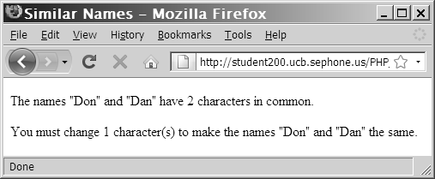
Determining the Similarity of
Two Strings (continued)
Figure 3-20 Output of a script with the similar_text()
and levenshtein() functions
PHP Programming with MySQL, 2nd Edition

Slide 45
Determining if Words are Pronounced Similarly
The soundex() and metaphone() functions determine whether two strings are pronounced similarly
Both functions return a value representing how words sound
The soundex() function returns a value representing a name’s phonetic equivalent
The metaphone() function returns a code representing an English word’s approximate sound
PHP Programming with MySQL, 2nd Edition

Slide 46
Determining if Words are Pronounced Similarly (continued)
$FirstName = "Gosselin";
$SecondName = "Gauselin";
$FirstNameSoundsLike = metaphone($FirstName);
$SecondNameSoundsLike = metaphone($SecondName);
if ($FirstNameSoundsLike == $SecondNameSoundsLike)
echo "<p>The names are pronounced the same.</p>";
else
echo "<p>The names are not pronounced the same.</p>";
PHP Programming with MySQL, 2nd Edition

Slide 47
Working with Regular Expressions
Regular Expressions are patterns that are used for matching and manipulating strings according to specified rules
PHP supports two types of regular expressions:
  POSIX Extended
  Perl Compatible Regular Expressions
PHP Programming with MySQL, 2nd Edition

Slide 48
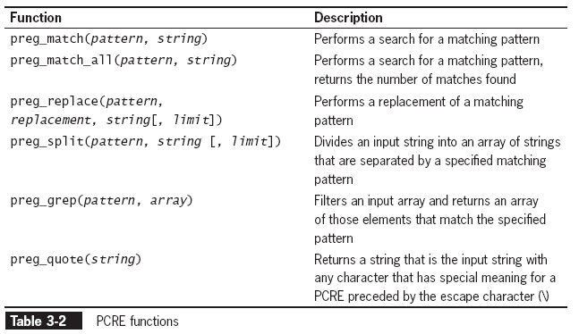
Working with Regular Expressions
(continued)
PHP Programming with MySQL, 2nd Edition

Slide 49
Working with Regular Expressions
(continued)
Pass to the preg_match() the regular expression pattern as the first argument and a string containing the text you want to search as the second argument
preg_match(pattern, string);
PHP Programming with MySQL, 2nd Edition

Slide 50
Writing Regular Expression Patterns
A regular expression pattern is a special text string that describes a search pattern
Regular expression patterns consist of literal characters and metacharacters, which are special characters that define the pattern-matching rules
Regular expression patterns are enclosed in opening and closing delimiters
  The most common character delimiter is the forward slash (/)
PHP Programming with MySQL, 2nd Edition

Slide 51
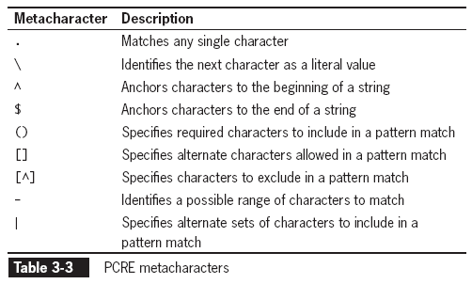
Writing Regular Expression Patterns
(continued)
PHP Programming with MySQL, 2nd Edition

Slide 52
Matching Any Character
A period (.) in a regular expression pattern specifies that the pattern must contain a value at the location of the period
A return value of 0 indicates that the string does not match the pattern and 1 if it does
$ZIP = "015";
preg_match("/...../", $ZIP); // returns 0
$ZIP = "01562";
preg_match("/...../", $ZIP); // returns 1
PHP Programming with MySQL, 2nd Edition

Slide 53
Matching Characters at the Beginning or End of a String
An anchor specifies that the pattern must appear at a particular position in a string
The ^ metacharacter anchors characters to the beginning of a string
The $ metacharacter anchors characters to the end of a string
$URL = "http://www.dongosselin.com";
preg_match("/^http/", $URL); // returns 1
PHP Programming with MySQL, 2nd Edition

Slide 54
Matching Characters at the Beginning or End of a String (continued)
To specify an anchor at the beginning of a string, the pattern must begin with a ^ metcharacter
$URL = "http://www.dongosselin.com";
  eregi("^http", $URL); // returns 1;
To specify an anchor at the end of a line, the pattern must end with the $ metacharacter
$Identifier = "http://www.dongosselin.com";
eregi("com$", $Identifier); // returns 1
PHP Programming with MySQL, 2nd Edition

Slide 55
Matching Special Characters
To match any metacharacters as literal values in a regular expression, escape the character with a backslash
(in the following example, the last four characters in the string must be ‘.com’)
$Identifier = http://www.dongosselin.com";
preg_match("/gov$/", $Identifier);//returns 0
PHP Programming with MySQL, 2nd Edition

Slide 56
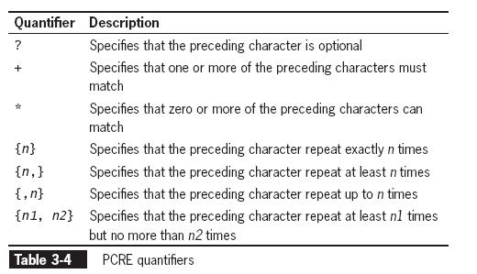
Specifying Quantity
Metacharacters that specify the quantity of a match are called quantifiers
PHP Programming with MySQL, 2nd Edition

Slide 57
Specifying Quantity
(continued)
A question mark (?) quantifier specifies that the preceding character in the pattern is optional
(in the following example, the string must begin with ‘http’ or ‘https’)
$URL = "http://www.dongosselin.com";
preg_match("/^https?/", $URL); // returns 1
PHP Programming with MySQL, 2nd Edition

Slide 58
Specifying Quantity
(continued)
The addition(+) quantifier specifies that one or more sequential occurrences of the preceding characters match
(in the following example, the string must have at least one character)
$Name = "Don";
preg_match("/.+/", $Name); // returns 1
PHP Programming with MySQL, 2nd Edition

Slide 59
Specifying Quantity
(continued)
A asterisk (*) quantifier specifies that zero or more sequential occurrences of the preceding characters match
(in the following example, the string must begin with one or more leading zeros)
NumberString = "00125";
preg_match("/^0*/", $NumberString);//returns 1
PHP Programming with MySQL, 2nd Edition

Slide 60
Specifying Quantity
(continued)
The { } quantifiers specify the number of times that a character must repeat sequentially
(in the following example, the string must contain at least five characters)
preg_match("/ZIP: .{5}$/", " ZIP: 01562");
// returns 1
The { } quantifiers can also specify the quantity as a range
(in the following example, the string must contain between five and ten characters)
preg_match("/(ZIP: .{5,10})$/", "ZIP:
01562-2607");// returns 1
PHP Programming with MySQL, 2nd Edition

Slide 61
Specifying Subexpressions
When a set of characters enclosed in parentheses are treated as a group, they are referred to as a subexpression or subpattern
(in the example below, the 1 and the area code are optional, but if included must be in the following format:)
1 (707) 555-1234
preg_match("/^(1 )?(\(.{3}\) )?(.{3})(\.{4})$/
PHP Programming with MySQL, 2nd Edition

Slide 62
Defining Character Classes
Character classes in regular expressions treat multiple characters as a single item
Characters enclosed with the ([]) metacharacters represent alternate characters that are allowed in a pattern match
preg_match("/analy[sz]e/", "analyse");//returns 1
preg_match("/analy[sz]e/", "analyze");//returns 1
preg_match("/analy[sz]e/", "analyce");//returns 0
PHP Programming with MySQL, 2nd Edition

Slide 63
Defining Character Classes
(continued)
The hyphen metacharacter (-) specifies a range of values in a character class
(the following example ensures that A, B, C, D, or F are the only values assigned to the $LetterGrade variable)
  $LetterGrade = "B";
  echo ereg("[A-DF]", $LetterGrade); // returns true
PHP Programming with MySQL, 2nd Edition

Slide 64
Defining Character Classes
(continued)
The ^ metacharacter (placed immediately after the opening bracket of a character class) specifies optional characters to exclude in a pattern match
(the following example excludes the letter E and G-Z from an acceptable pattern match in the $LetterGrade variable)
$LetterGrade = "A";
echo ereg("[^EG-Z]", $LetterGrade); //
returns true
PHP Programming with MySQL, 2nd Edition

Slide 65
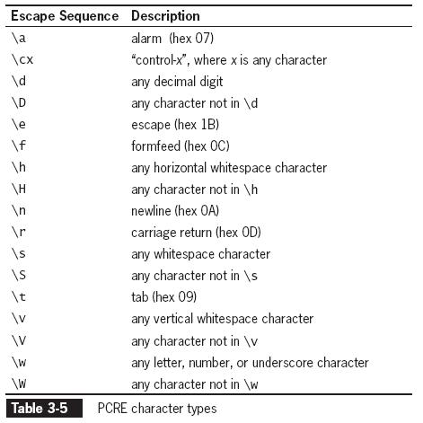
Defining Character Classes
(continued)
PHP Programming with MySQL, 2nd Edition

Slide 66
Matching Multiple Pattern Choices
The | metacharacter is used to specify an alternate set of patterns
  The | metacharacter is essentially the same as using the OR operator to perform multiple evaluations in a conditional expression
PHP Programming with MySQL, 2nd Edition

Slide 67
Pattern Modifiers
Pattern modifiers are letters placed after the closing delimiter that change the default rules for interpreting matches
  The pattern modifier, i, indicates that the case of the letter does not matter when searching
  The pattern modifier, m, allows searches across newline characters
  The pattern modifier, s, changes how the . (period) metacharacter works
PHP Programming with MySQL, 2nd Edition

Slide 68
Summary
The concatenation operator (.) and the concatenation assignment operator (.=) can be used to combine two strings
An escape character tells the compiler or interpreter that the character following the escape character has a special purpose. An escape character combined with one or more other characters is called an escape sequence
PHP Programming with MySQL, 2nd Edition

Slide 69
Summary (continued)
Simple string syntax allows you to use the value of a variable within a string by including the variable name inside a text string with double quotation marks
The type of structure in which variables are placed within curly braces inside of a string is called complex string syntax
The most commonly used string-counting function is the strlen() function, which returns the total number of characters in a string
PHP Programming with MySQL, 2nd Edition

Slide 70
Summary (continued)
The str_word_count()function returns the number of words in a string
The strtoupper(), strtolower(), ucfirst(), lcfirst(), and ucwords() functions all change the case of characters in the string
The substr() function returns the specified portion of a string
PHP Programming with MySQL, 2nd Edition

Slide 71
Summary (continued)
When applied to text strings, parsing refers to the act of dividing a string into logical component substrings or tokens
There are two types of string search and extraction functions: functions that return a numeric position in a text string and those that return a character or substring
You use the str_replace(), str_ireplace(), and substr_replace() functions to replace text in strings
PHP Programming with MySQL, 2nd Edition

Slide 72
Summary (continued)
The strtok()function breaks a string into smaller strings, called tokens
You use the str_split() or explode() function to split a string into an indexed array, in which each character in the string becomes a separate element in the array
The implode() function combines an array’s elements into a single string, separated by specified characters
PHP Programming with MySQL, 2nd Edition

Slide 73
Summary (continued)
The strcasecmp() function performs a case-insensitive comparison of strings, whereas the strcmp()function performs a case-sensitive comparison of strings
The similar_text() and levenshtein() functions are used to determine the similarity of two strings
You can use the soundex() and metaphone() functions to determine whether two strings are pronounced similarly
PHP Programming with MySQL, 2nd Edition

Slide 74
Summary (continued)
Regular expressions are a pattern of specially formatted strings that can be used to validate the structure of a string
Regular expressions are made up of both literal characters and special characters, called metacharacters, which define the pattern-matching rules
In a regular expression, a backslash character (\) is used to match metacharacters as literal values
PHP Programming with MySQL, 2nd Edition

Slide 75
Summary (continued)
Quantifiers are metacharacters that specify the number of times a particular match may occur
Subexpressions are characters contained in parentheses within a regular expression
The format and quantity of the characters in the subexpression can be defined as a group
A character class is multiple characters enclosed in square brackets ([]) that are treated as a single unit
PHP Programming with MySQL, 2nd Edition

Slide 76
Summary (continued)
The | metacharacter allows a string to be comprised of an alternate set of substrings. The | metacharacter performs essentially the same function as the Or (||) operator in conditional expressions
PHP Programming with MySQL, 2nd Edition

